Slide 1
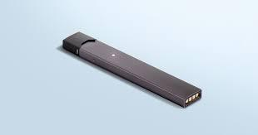
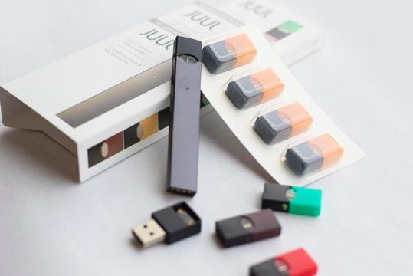
E-CIGARETTE HEALTH CRISIS: WHAT DO WE KNOW ABOUT THE RISK PERCEPTIONS, ATTITUDES, NORMS, AND USE OF E-CIGARETTES AMONG COLLEGE STUDENTS
Dr. Taejin Jung, Dr. Minhao Dai, and Dr. Katherine Thweatt, State University of New York at Oswego
E-cigarette use and its averse consequences E-cigarettes have rapidly become the most common tobacco products used by youth, exceeding the prevalence of combustible tobacco. 3.62 million high and middle school students (20.8% among high school students and 4.9% among middle school students) were current users of e-cigarettes and other Electronic Nicotine Delivery Systems (ENDS) (Walley, Wilson, Winickoff, & Groner, 2019). E-cigarette use increases risk for cough, wheezing, asthma exacerbations, and severe pulmonary disease (Report, 2018). The purpose of this research is to understand college students’ perception and use e-cigarette, main reasons and influencers of (not) using e-cigarette, and main situations of prompting e-cigarette use.
Findings
Respondents’ average age is 21.4 years old.
Among respondents, majority of them are female (61%) and white (75.5%).
Students of all four undergraduate years and graduates responded. Among them, seniors responded most (29.7%).
Most students live at residence hall (49.2%) and privately-owned apartment or house (44.1%).
Research Questions RQ1. How do college students perceive and use e-cigarettes? RQ2. What are the reasons (not) of using e-cigarettes? RQ3. What are the situations prompting e-cigarette use? RQ4. Who are the influencers of using e-cigarettes? RQ5. Are there differences of perceptions, uses, situations and influencers of e-cigarette use between non-smokers and non-smokers?
E-cigarette smokers are more likely to live with smokers (72% vs. 27.9%).
E-cigarette smokers are more likely to allow other smokers to smoke in the living quarter (48.9% vs. 30.6%).
Non-smokers are more like to think that e-cigarette has same or lesser level of nicotine than traditional tobacco (42.8% vs. 36.6%).
E-cigarette smokers are younger than non-e-cigarette smokers (20.69 vs. 21.68 age old).
Feeling of financial security is not a meaningful factor of using e-cigarette.
E-cigarette smokers have more close friends who smoke than non-e-cigarette smokers (4.16 vs. 2.39 people).
More non-e-cigarette smokers support for the current e-cigarette smoking policy like the e-cigarette flavor ban than e-cigarette smokers.
”Easy to use”, “variety of flavors”, “friends use them”, “get a buzz”, “lack of bad smell”, “greater social acceptability”, “relieve stress”, “sleek design” and “curiosity” are main reasons to use e-cigarette products among other reasons.
➔ When comparing smokers and non-smokers, more smokers use e-cigarette because it is “easy to use”, “get a buzz”, ”lack of bad smell”, “relieve stress” while non-smokers consider to use e-cigarette because ”friends use them”, “peer pressure” and “less addictive than traditional cigarette.”
Vaping related negative health consequences (e.g., respiratory diseases, cancer/heart diseases, skin aging) are the main reasons of not using e-cigarette products. When comparing smokers and non-smokers
➔ When comparing smokers and non-smokers, non-smokers concern more on these negative health consequences than smokers.
”Social gathering “ and “being with friends who vape” are the two main situations that make people to smoke e-cigarette more.
➔When comparing smokers and non-smokers, smokers are more susceptible to smoke e-cigarettes under these circumstances.
Parents followed by partners, siblings and friends are the main influencers of not using e-cigarette.
➔ Compared with non-e-cigarette smokers, smokers are more susceptible of these influencers. However, parents are the main influencer to both non-smokers and smokers without statistically significant difference.
Research Methods
Data collection: Online survey through Qualtrics with the survey distribution support by the Institute of Research and Assessment of SUNY Oswego.
Measurement: Standardized survey questionnaire to measure demographic and e-cigarette perception and use related variables.
Sampling: Convenient sampling from SUNY Oswego students.
Data collection period: December 2019.
Sample size: 879 (About 10% response rate)
Incentive: $10 cash rewards for 25 randomly selected respondents.
Data analysis: SPSS was used to do descriptive and analytical analysis (e.g., Chi-square test and t-test).
[Conclusions and Discussions]
While about one out of five college students (22.3%) are current e-cigarette smokers, 8.8% of them was ex-e-cigarette smokers and didn’t smoke for the past three months, which implies the importance of smoking cessation campaign and education.
87.3% and 51.3% of college students answered that they co-use alcohol or marijuana sometimes or always when they smoke e-cigarettes. E-cigarettes could actually serve as a gateway drug to users which will make them more likely to use other illicit drugs like cocaine.
It is critical to understand the main reasons of using (or not using) e-cigarettes. Peer pressure is the main reason of non-smokers to become to use e-cigarettes, while current smokers continue to use e-cigarettes because of their positive functionalities such as easy to use, lack of bad smell and relieving stress. While e-cigarette smokers are more susceptible of peer pressure, parents are the most important influencer to both smokers and non-smokers on their smoking decision.
E-cigarette smokers (compared to non-smokers) are more likely to live with smokers and allow other smokers to smoke in the living quarters. Smoke-free legislation is one of the most effective environmental smoking control strategies along with regulations on sales and marketing and taxation.
It is always true that peer-pressure is one of the biggest predictors of beginning an use of e-cigarettes. E-cigarette smokers have more close friends who smoke than non-e-cigarette smokers (4.16 vs. 2.39 people).
Average age of the first e-cigarette use is 18.1 years old. The typical age of incoming freshmen in U.S. college is 18 or 19.
Most current e-cigarette smokers use e-cigarette for “1-3 years (57.3%)”, followed by “1~3 months (15.2%)” and “less than 3 months (11.8%).”
About one out of three respondents live with e-cigarette smokers (37.7%) and allow smoking inside their residency (34.7%).
About six out of ten (58.6%) respondents think e-cigarettes contain more nicotine than traditional tobacco products, while about three out of ten think about the same level of nicotine was included (32.3%).
22.3% of respondents are current e-cigarette smokers and 8.8% of them was ex-e-cigarette smokers and didn’t smoke for the past three months.
Menthol/Mint is the most favored e-cigarette flavor (60.8%) followed by fruit (14.6%) and cocktail of multiple flavors (10.1%).
Nine out of ten respondents use e-cigarette with alcohol sometimes (55.3%) or always (32.0%).
About half of respondents use e-cigarette with marijuana sometimes (36.5%) or always (14.8).
[Conclusions and Discussions]
The average age of the first e-cigarette use is 18.1 years old and average age of e-cigarette smokers and younger than non-e-cigarette smokers. Most college students began e-cigarette use at the time of high school senior or college freshman. People who start smoking at an early age are more likely to develop a severe addition to nicotine that those who start at later age. So, it is critical to make early age anti-smoking initiation campaign and education.
27% of current e-cigarette smokers use e-cigarette product less than 1 year and 84.3% of them use it less than 3 years. So, it is critical to help short-term e-cigarette users to quit smoking.

